Slide 1




Project 1: API Back-End Development
University of British Coloumbia
Wasi-ul-Hassan Raza
Calvin Qu
Po-Chia Wei
Austin Wong

Slide 2

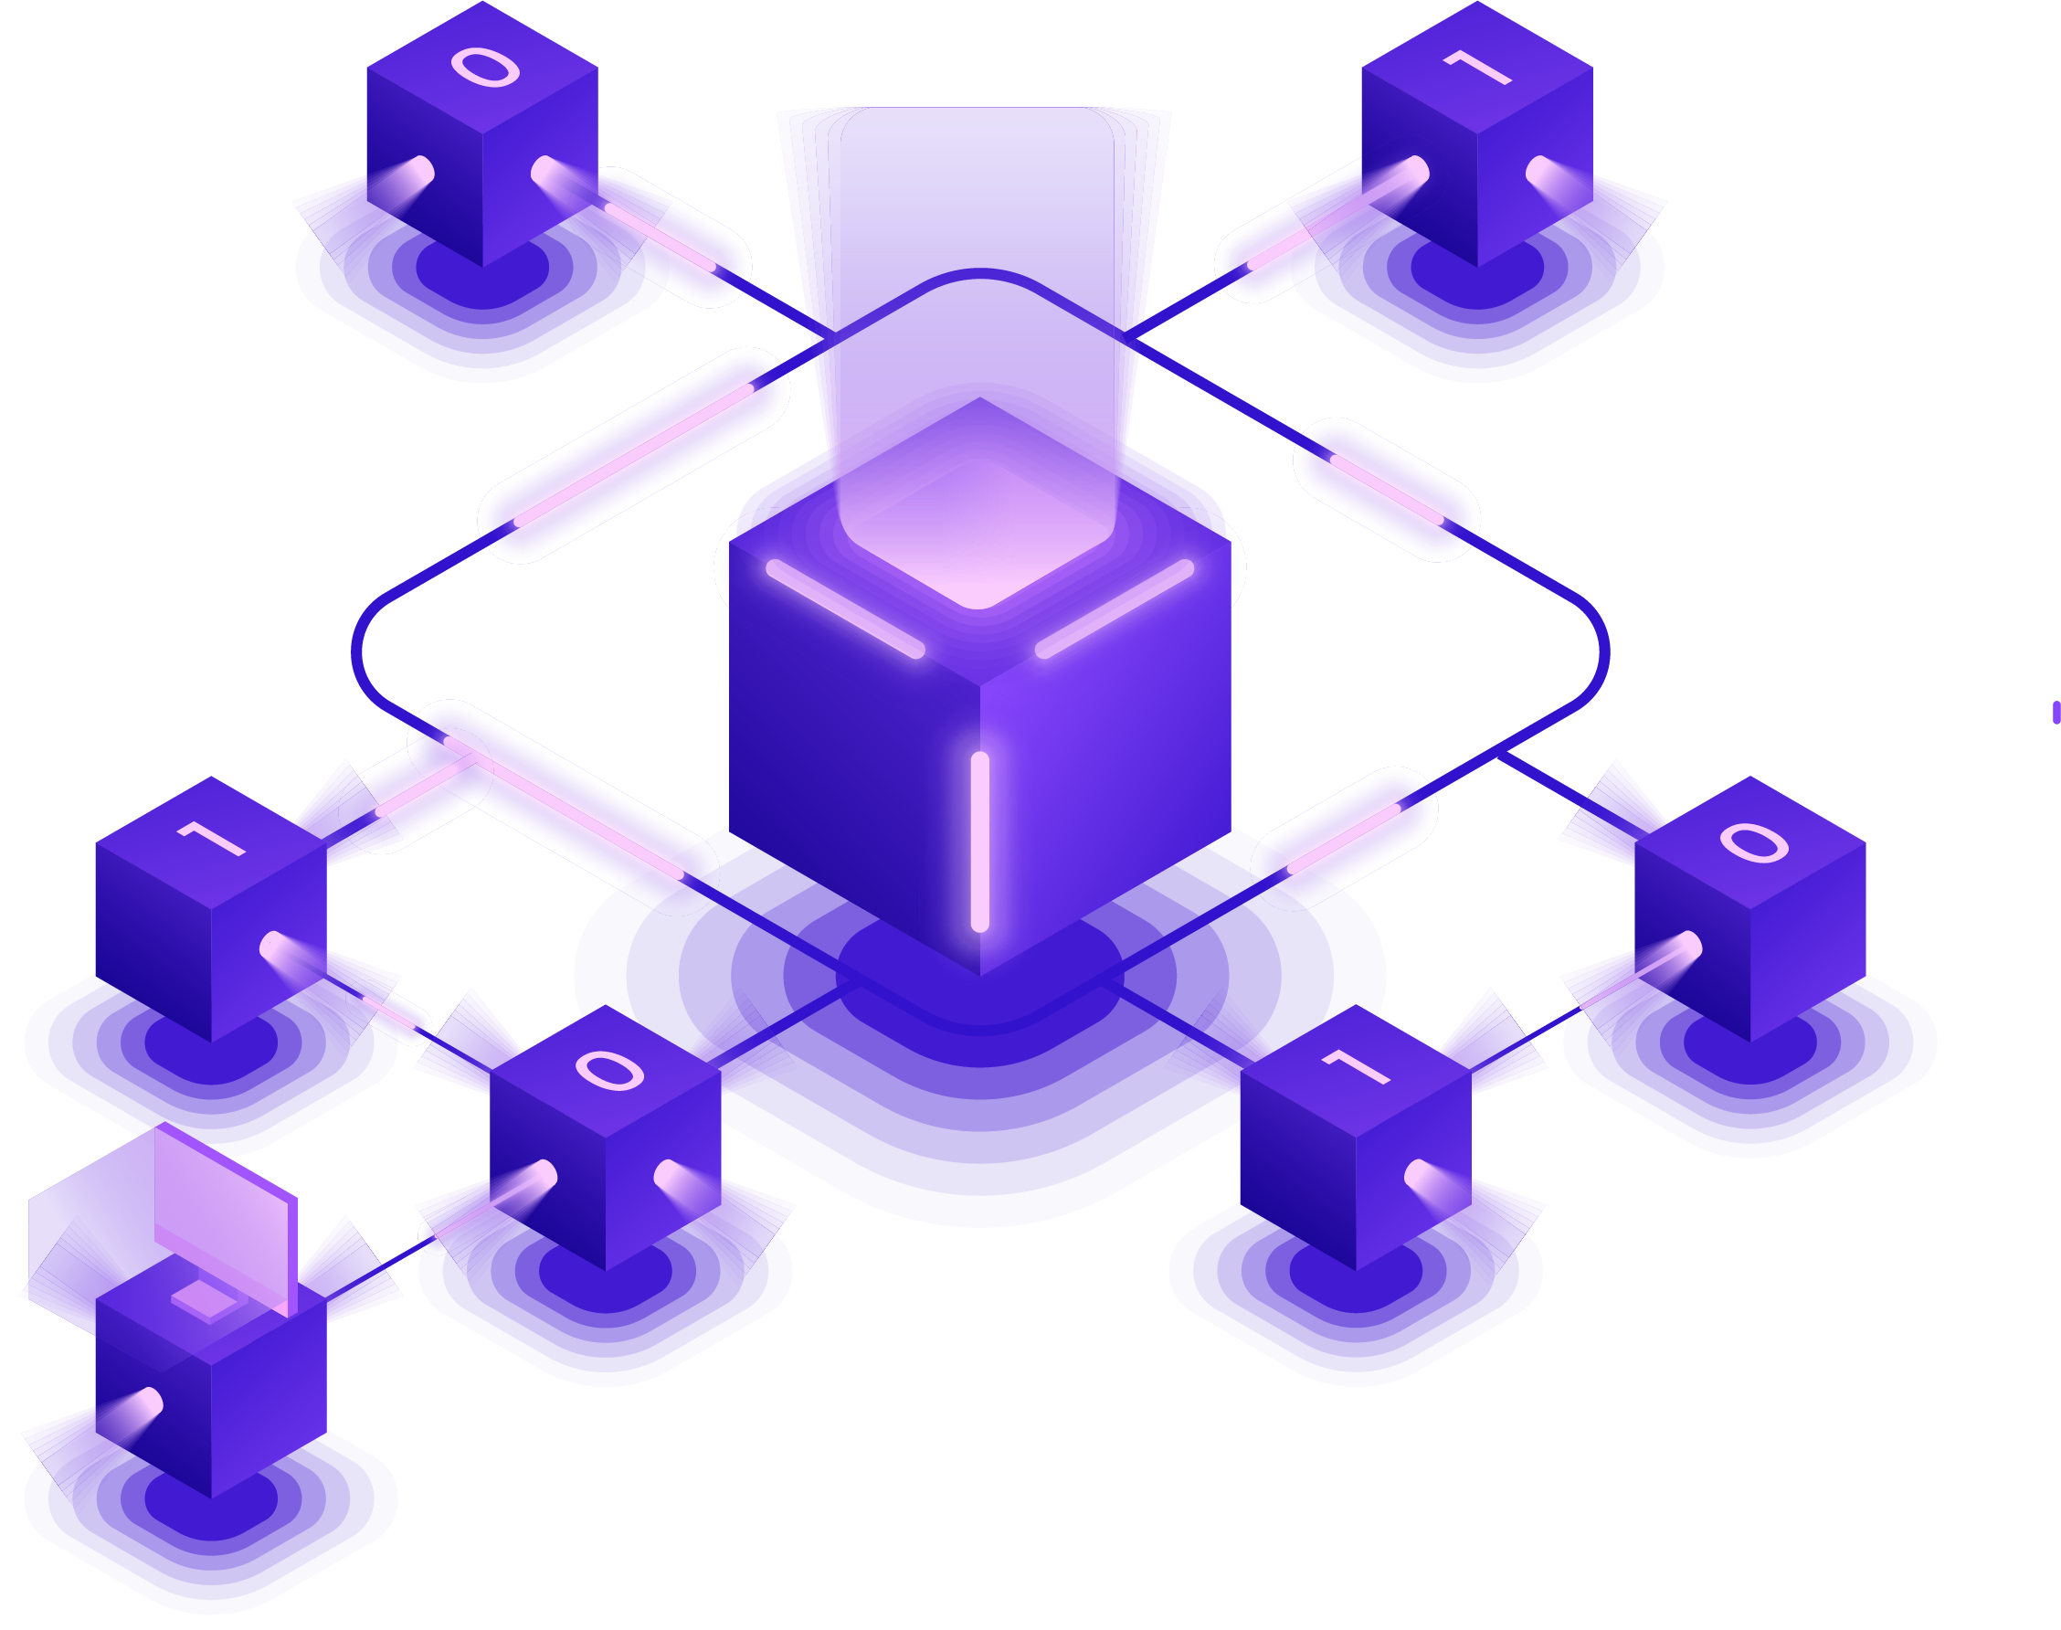
HelpYa Services Inc.
Helpya is a trade service acquisition platform
Clients
Harrison Larson
Thomas Pattison
What is the problem?
Back end API development
Cross platform (web, ios, android)

Slide 3


Target Audience
Businesses
Creating advertisement
Gaining clientele
Consumers
Seeking services
Communicating with businesses

Slide 4

Requirements
The Helpya platform backend API needs to do the following:
Store and manipulate user information
Delete user accounts
Search for a service
Login
Transactional endpoints
Stripe
Messaging
Four types of users

Slide 5
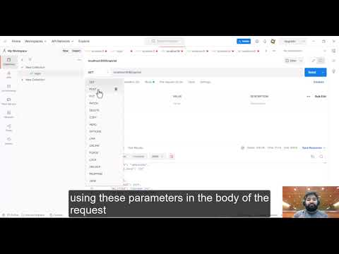
Video

Slide 6

API Development
Key Components
Database (MySQL)
Tokenization (Express.js)
Transaction API (Stripe)
Using Node js
Compatibility with other frameworks like react angular vue
Scalability
Large community support
CI/CD
Heroku
Drone
Notes:
cost to maintain and reliability

Slide 7
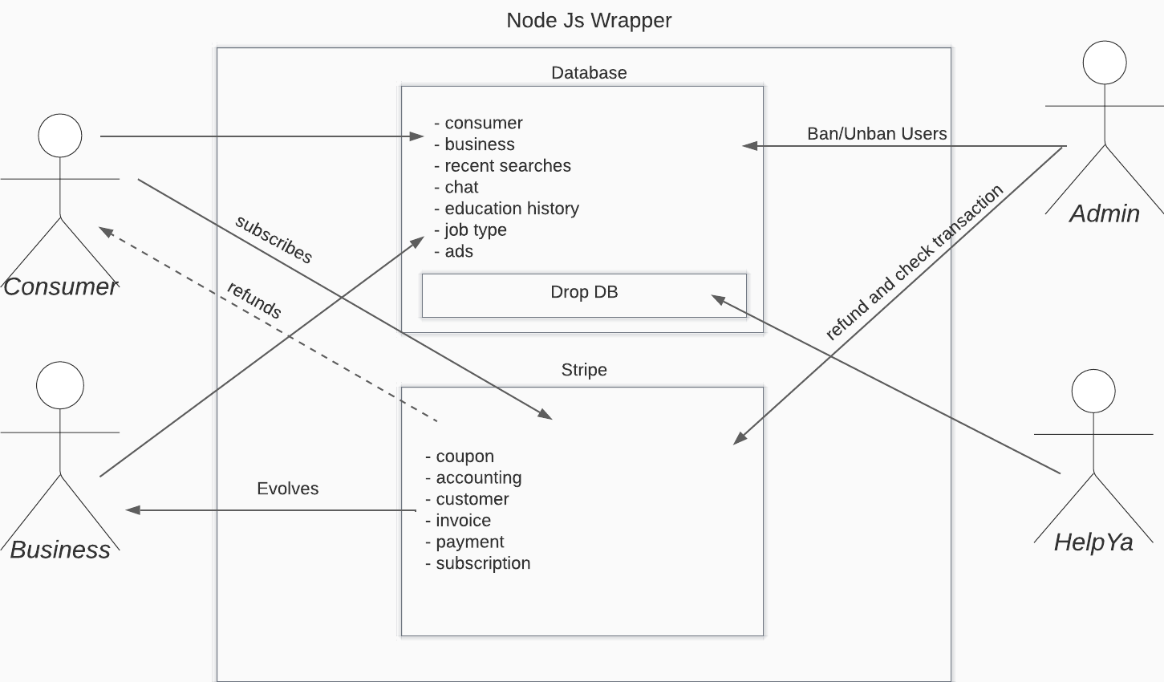
User Case Diagram

Slide 8
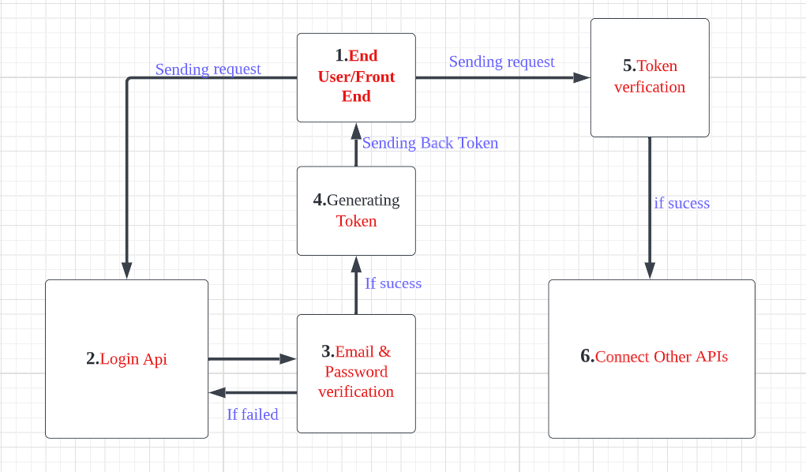
Login
If failed
‹#›

Slide 9
zzz
Testing
Postman
Unit Test
Endpoint Test
Integration Test
User Test

Slide 10

Postman
Routes
Controller
Model
Database

Slide 11

Unit Test
Mocha Chai method
Using mock-up Cache Database
Test every independent module
Coding Difficulty: Easy

Slide 12
Endpoint Test
Mocha Chai method
Test all endpoints
Able to test without database
Coding Difficulty: Medium

Slide 13
Integration Test
Mocha Chai method
Test interaction between integrated units
Connected to database
Process dummy data
Coding Difficulty: Hard

Slide 14
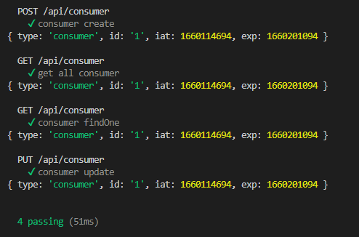
Testing Example

Slide 15
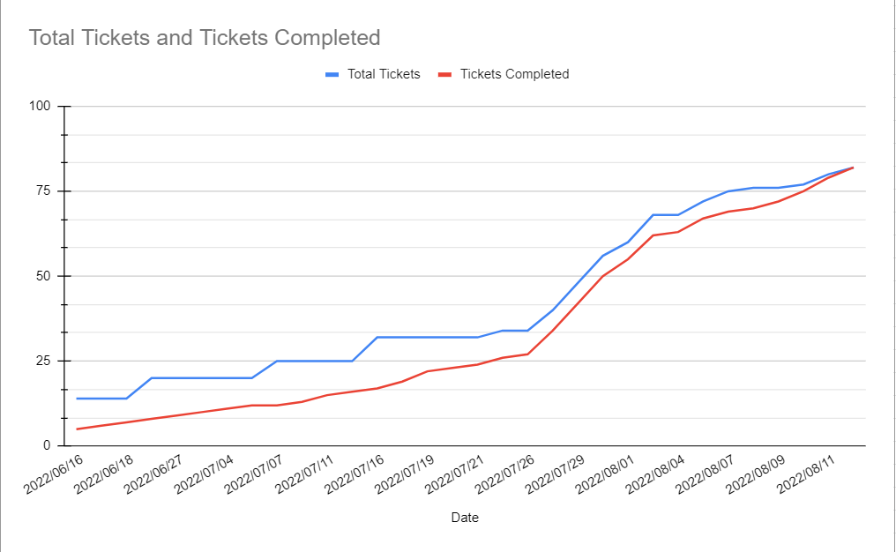
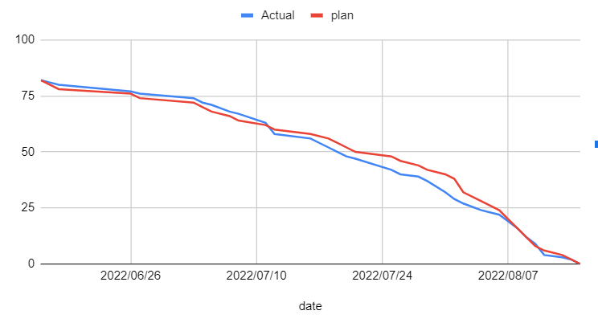
Burn Up/Down Chart

Slide 16


Project Management
Workflow: Agile
Scrum meetings
Tickets to manage tasks
Make
Tickets
Assign
Tickets
Do
Tickets
Testing

Slide 17
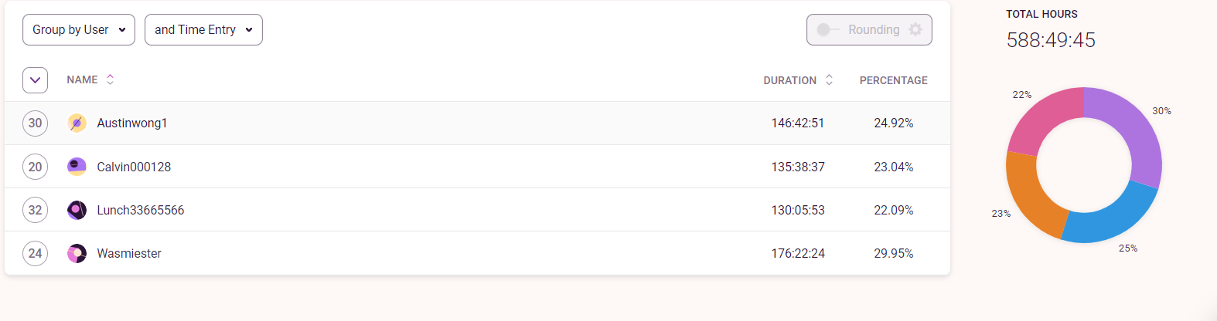
Total Project Time

Slide 18
Challenges Throughout Development
Coding challenges
Drone
Updating Requirements
Evoving Requirements
Breaking Down Tasks
Route Guards
Pagination
Insertion Guard

Slide 19

Conclusion

Slide 20

Any Questions?

